Slide 1



Characterizing, Exploiting, and Detecting DMA Code Injection Vulnerabilities in the Presence of an IOMMU
Alex MArkuze, Shay Vargaftik, GIL Kupfer, Boris PismeNny, NADAV AMIT, ADAM MORRISON, DAN TSAFRIR
Notes:
Hi, my name is Alex for the past three years I was working on the Pathway project, with Israel. And now I’m currently at the Veclocloud CTO office, and.
Today I will present a paper we have submitted to us21 About DMA attacks. This work has three VRG co-authors and a prior VRG intern.

Slide 2
Characterizing, Exploiting, Detecting and Preventing DMA Attacks in the Presence of an IOMMU
Markuze Alex
Advisors: DAN Tsafrir & Adam Morrison

Slide 3
overview
Background
Characterizing, Exploiting and Detecting
Prevention

Slide 4
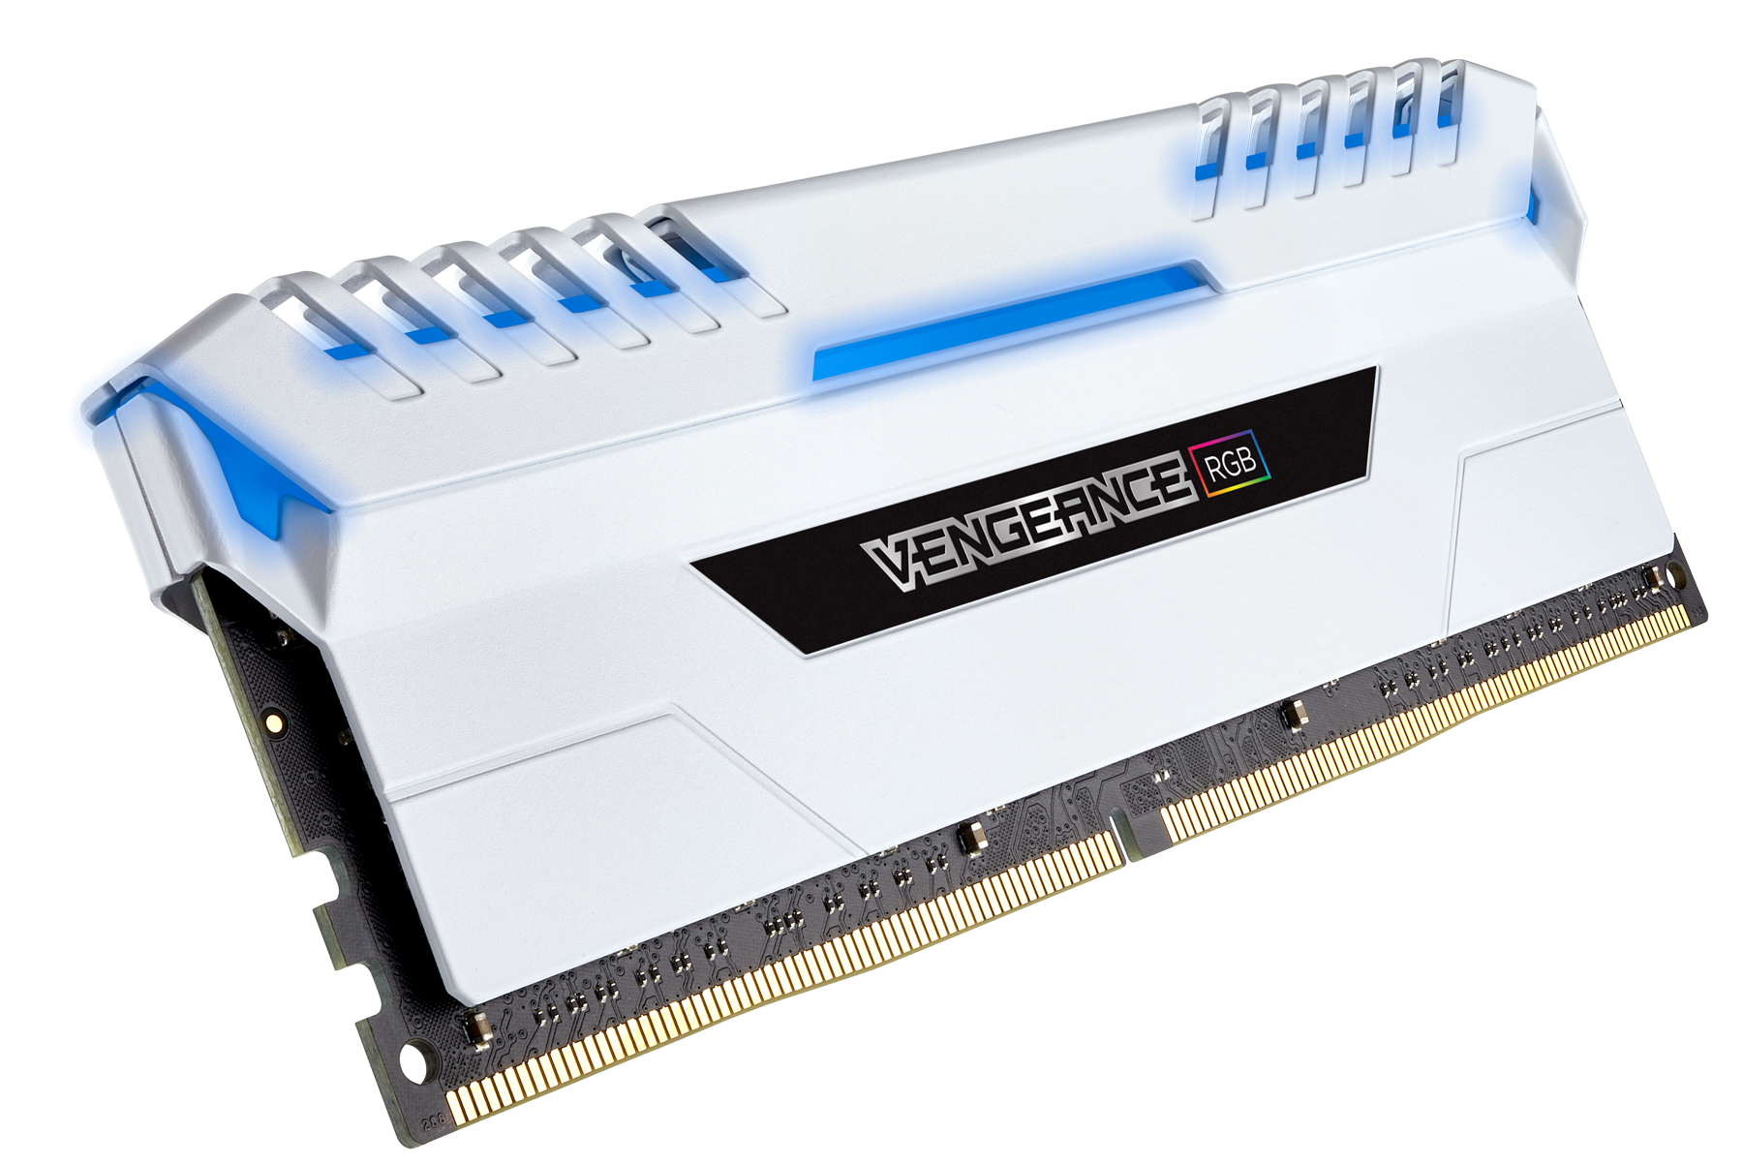
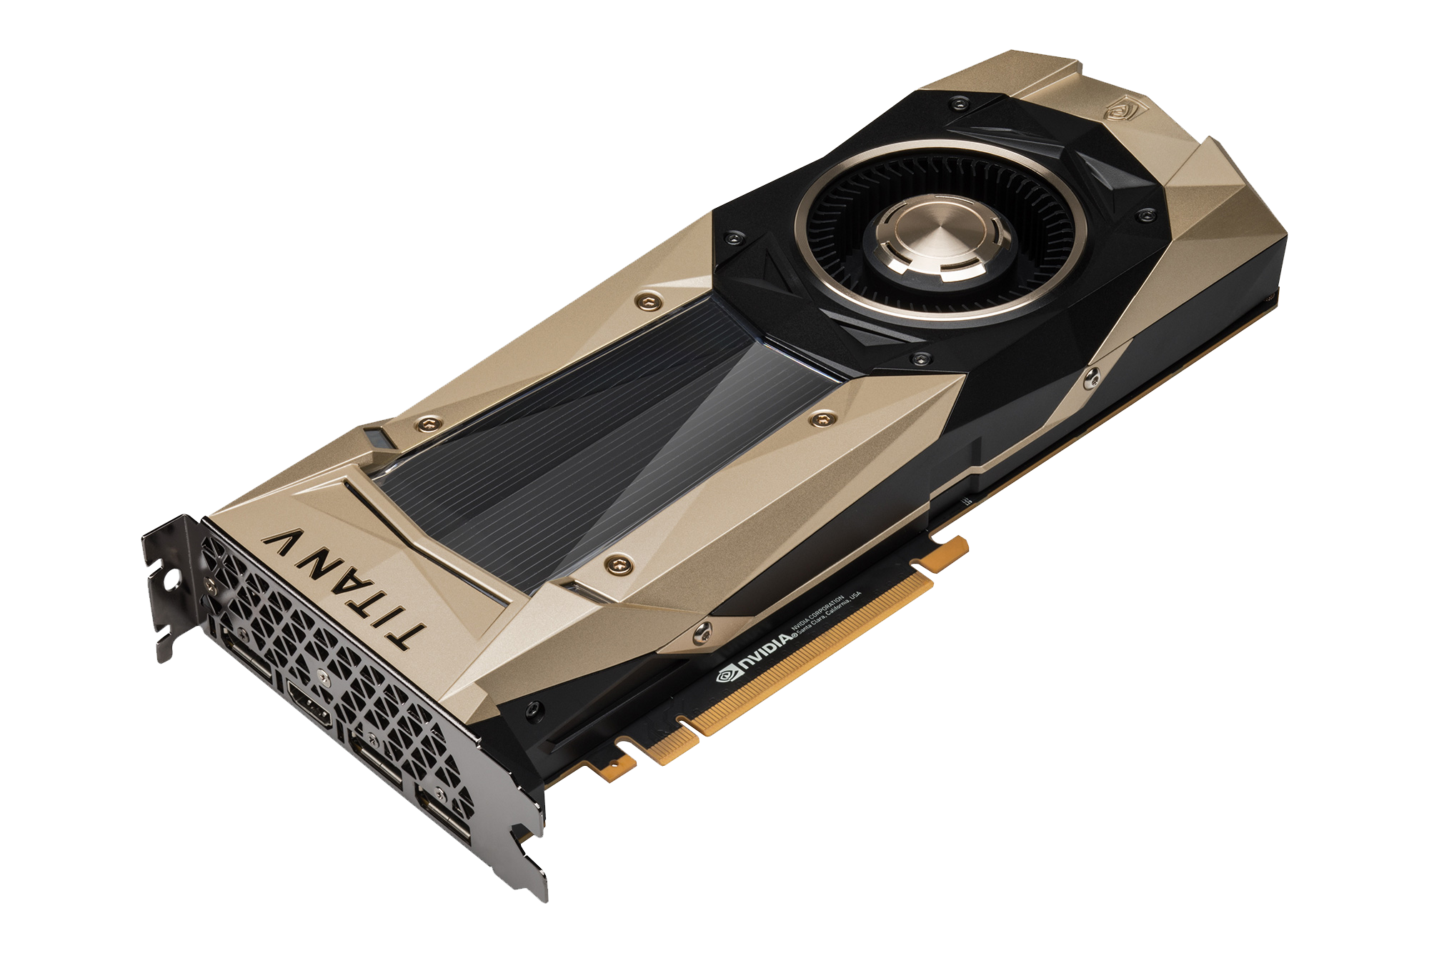
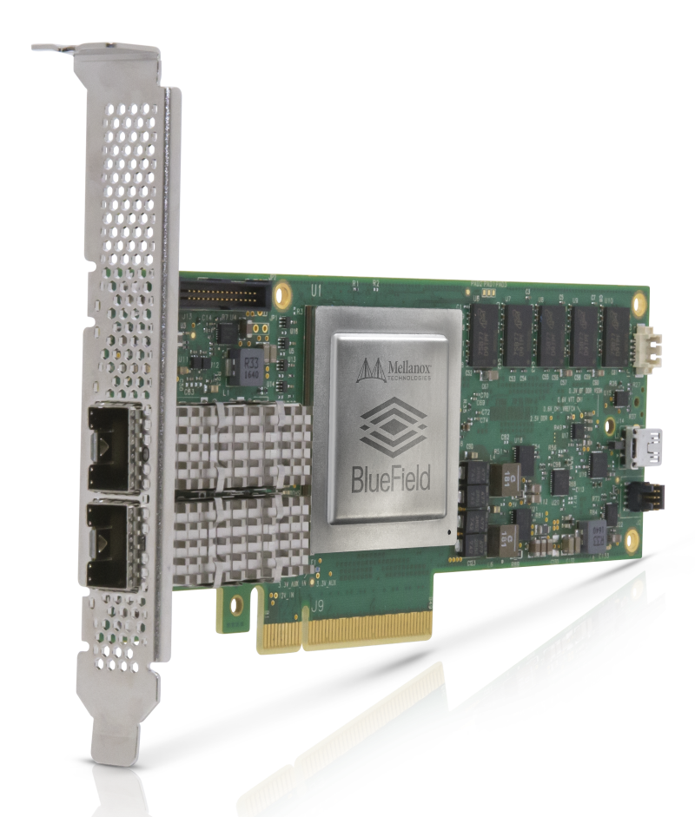
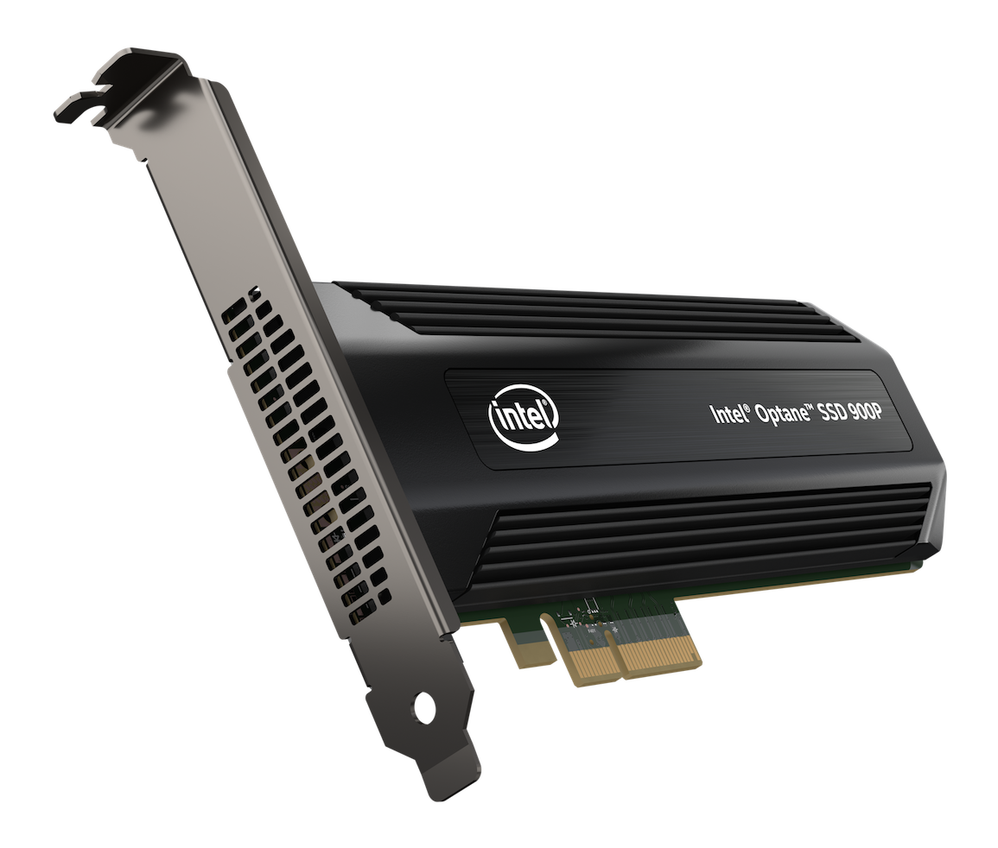
DMA
Text
Notes:
DMA, or direct memory access. Its when, an attached device can access the main memory without involving the cpu.
Thats Devices like GPUs, SSDs and Network Cards . These devices have their own memory and cpus(1) and can obviously run their own code.(0:35)

Slide 5
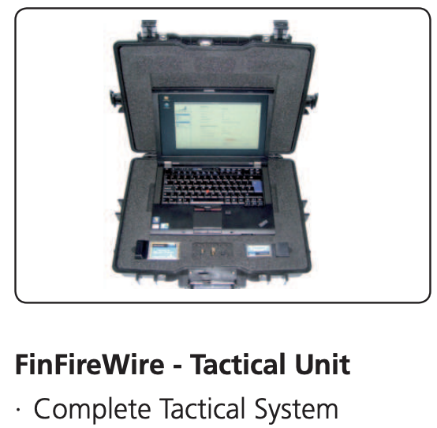
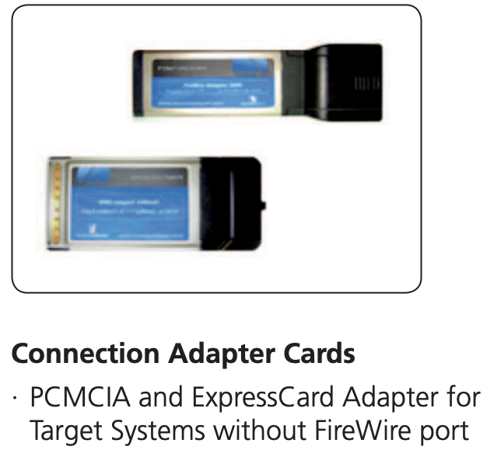
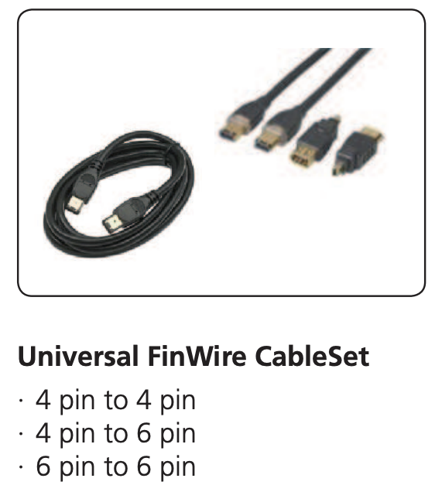
DMA AttackS
BACKGROUND
A Malicious, DMA-Capable device compromises the system.
FinFireWire https://wikileaks.org/spyfiles/files/0/299_GAMMA-201110-FinFisher_Product_Portfolio-en.pdf
Notes:
DMA, also allows a malicious device to read or modify sensitive data. This is called a DMA attack. It’s a side channel attack where, a malicious DMA capable device compromises a system. DMA means direct memory access, no CPU involvement. A common capability that(+) NICs,GPUS, NVME devices have, and many dongles like firewire and thunderbolt.(+) One notorious example is this FinFireWire unit(+). Basically a Lenovo Thinkpad with a firewire adapter that can be used to take over the target machine.

Slide 6
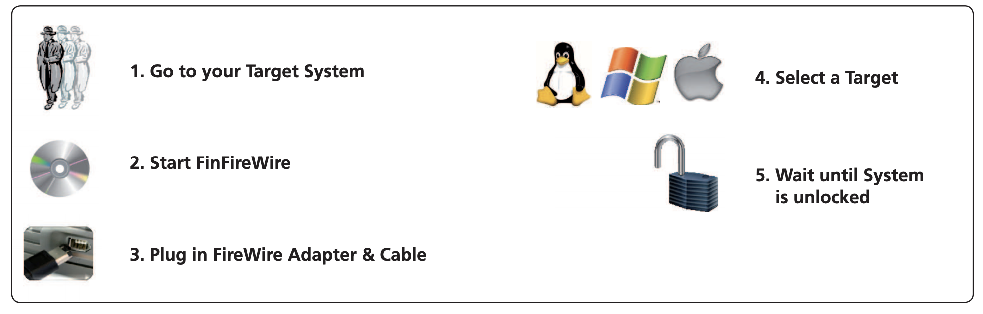
FinFisher USAGE
BACKGROUND
Plug and Play.
The Malicious device reads and modifies target memory.
Notes:
The downside of a DMA attack is that an attacker needs physical access to the target system. But other than that its just plug and play. A malicious device with an unobstructed access to the systems memory will bypass any defence.

Slide 7
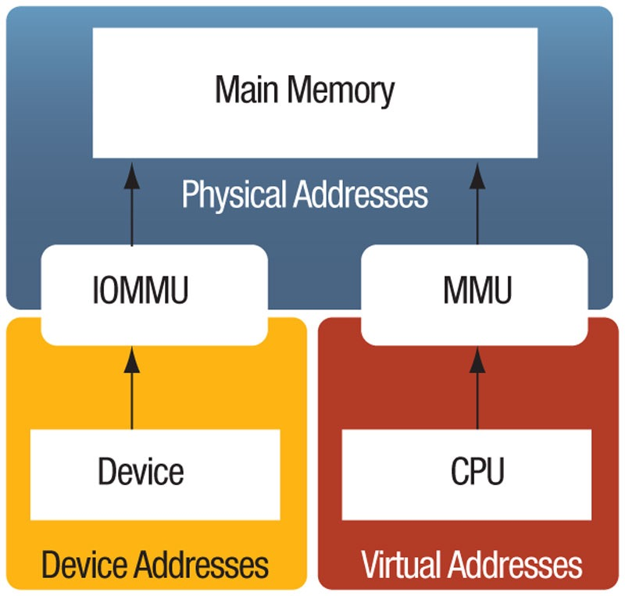
IOMMU!
background
Address Space Isolation (IOVA).
Restricts Device access Only to OS defined Pages.
Notes:
To prevent arbitrarily access to the memory, modern systems have IOMMU hardware. The IOMMU works for devices just like the MMU works for processes. It provides virtual memory support for the attached device. Meaning, that the device can access only those pages that are listed in the
I/O page table. This page table is controlled by the OS. With an IOMMU, the device can access the main memory only via IO virtual addresses, IOVAs.(01:50)

Slide 8


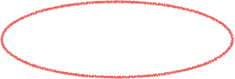
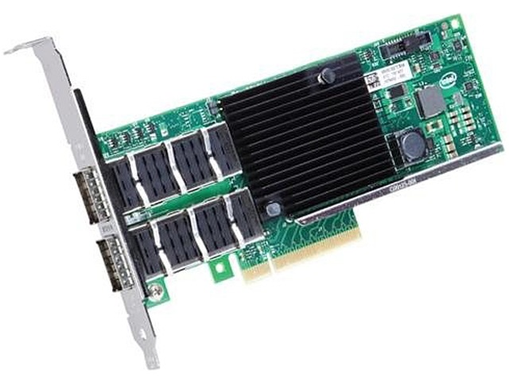
Packet transmission using DMA API
1. dma_map(VA)
IOMMU
Allocate IOVA
Page Table
Update dev page table
IOVA -> PA
2. Transmit Packet
IOTLB
IOVA -> PA
3. dma_unmap(IOVA)
Remove entry from page table
Flush IOTLB
Free IOVA
Notes:
To demonstrate how IOMMU is used via the DMA API, let’s follow a sent a packet.
1. First the nic driver dma_map-s the packet(1). the operation creates a new io virtual address(2), the I/O page table is populated(3 + 4), thats the the blue box on the slides. The red va and yellow IOVA point to the same physical address(5).
2. Second(6), the nic reads the packet using the IOVA(7) and the packet is sent.When the IOVA is accessed the IOTLB is updated.(8)The IOTLB is a small translation (*) cache just like the TLB in the MMU.(9) (*)
3. Third(10), When the packet has been sent. The packet is dma_unmapped. unmap (11) removes the translation from the devices page table(12), flushes (13) the entry in the IO/TLB(14 +15). Now the NIC cant access the physical page anymore (3:00)

Slide 9
IOMMU problem #1 — performance
Notes:
But there are obviously some problems with that. The first problem is degraded performance. These are netperf results for a 40 gigabit nic used by a single core, without iommu (1) and with iommu(2). As you can see, using the IOMMU reduces the throughput from 20 Gbps to about 7
.(3+4) With sixteen cores. Iommu (5) performance is worse, and this is with all cores utilized at 100%, so iommu dosent scale really well. This is the due of the IOTLB flush cost and the need to sync on other shared resources. (3:40)

Slide 10
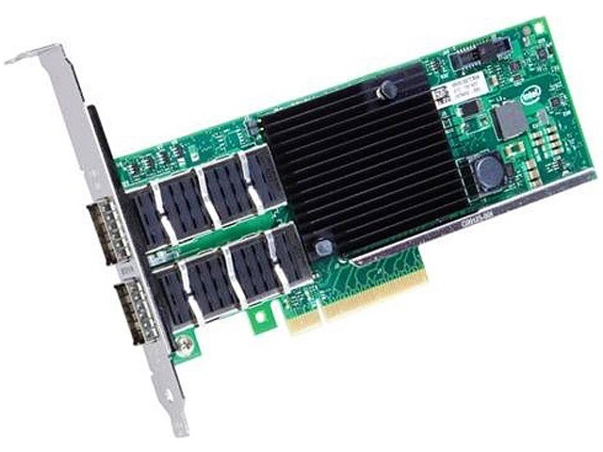
IOMMU security problem — sub page
NIC needs to access
NIC
CAN access
4KB page
Confidential data
Notes:
The problems don’t end there, IOMMU granularity is of 4K pages.This means that any data co-located(1) on a page with a DMA buffer can be accessed by the device! , for example the smallest network packet is about 48B(2) so this is everything the nic needs to access and this (3) is everything the NIC can access. Each time a 48 byte packet is mapped the NIC can access the whole page. This is the sub page protection problem.(4:00)

Slide 11
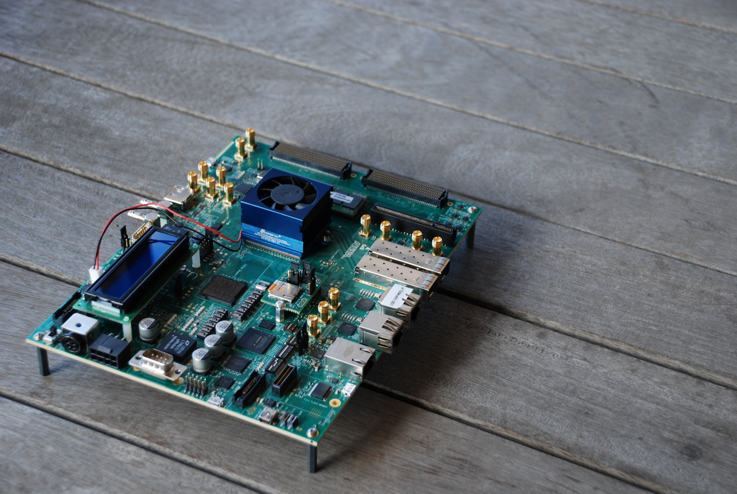
IOMMU subverting DMA attacks
BACKGROUND
IOMMU is inadequate to prevent DMA attacks.
A DMA Capable malicious device.
(http://thunderclap.io/)
NDSS 2019
Notes:
I/O packets are often smaller than a page, but the IOMMU granularity is 4K at its finest. A malicious device can exploit co-located CPU objects to execute its attack. This is thunderclap an open source project was presented last year at NDSS.
Using this device Marketos and colleagues scanned and found multiple DMA vulnerabilities.

Slide 12
challenges
Cointributions
No structured way to reason about DMA vulnerabilities.
No known way of detecting vulnerabilities.
DMA vulnerabilities are not quantified.
DMA attacks are not well understood.

Slide 13
overview
Background
Characterizing
Detecting
Exploiting

Slide 14

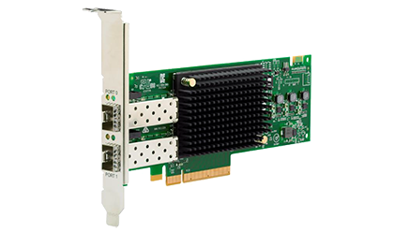

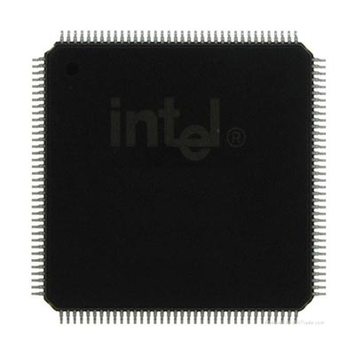


SUB-PAGE VULNERABILITY : TYPES
Structured REASONInG
Unintended access
Mapped by IOVA A
I/O Device
Mapped by different IOVA
IOMMU
Read IOVA A
I/O buffer
I/O buffer
I/O buffer
OS metadata
4KB Page
Driver Metadata
I/O buffer
I/O buffer
Incidental
(a)
(b)
(c)
(d)
(c)
(b)
Notes:
We introduce the four types of sub-page vulnerability. Type A (+) when the mapped 32 bytes allowed access to the callback-pointer. Type B (+) when a Kernel data structure was exposed. Type A is a driver design choice and Type B is core OS API, that the driver uses. And the colocation of the two data structures resulted in Type C vulnerability, that creates privilege escalation. These are fully deterministic and can be found with static code analysis - as we show next. The final (+) is incidental where a non I/O object was allocated from a page that contains a mapped I/O object. Luckily these can also be detected - as we also demonstrate.

Slide 15

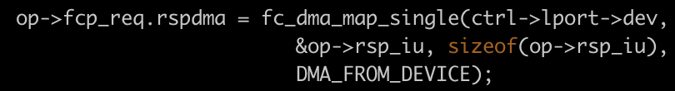
SUB-PAGE VULNERABILITY : EXAMPLE
sub-Page
Broadcom LPe32002 FC HBA
drivers/nvme/host/fc.c __nvme_fc_init_request
__nvme_fc_init_request
96B
32B
Notes:
Lets show an example, in a generic nvme over fc driver. This Broadcom FC device is one example of a relevant device. In this fc_init_request function, namely when you plug an FC cable into this device, a dialog via DMA is initiated. The function maps this command (+) structure 96 Bytes to be read by the client. And also (+) this response a data structure of 32 Bytes to be written by the client.

Slide 16
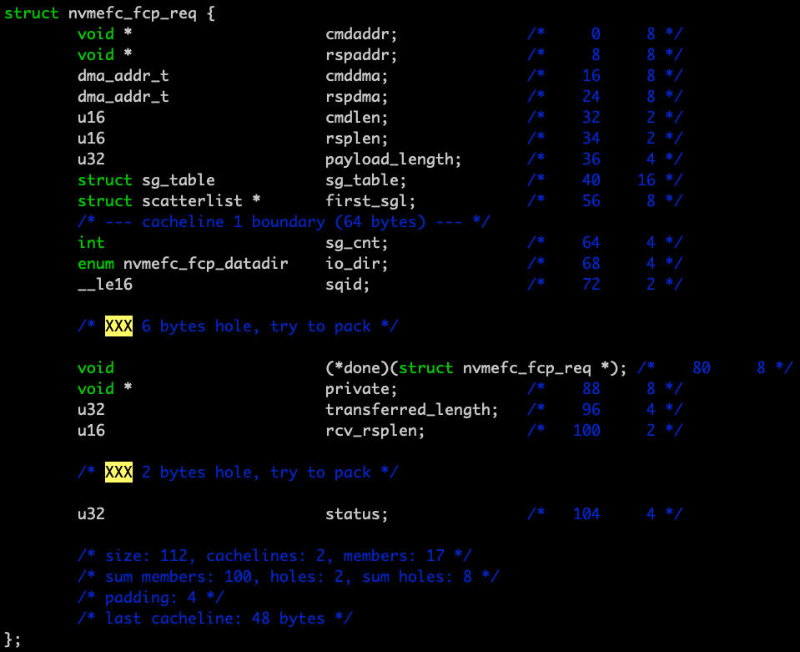
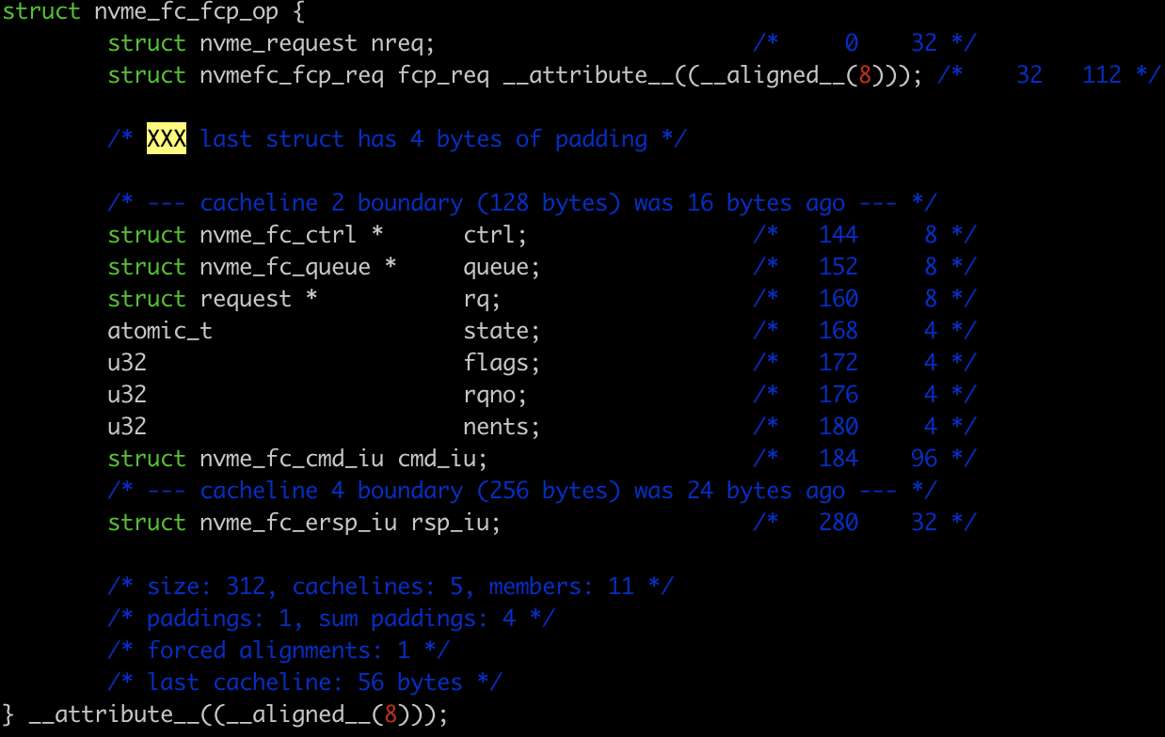
SUB-PAGE VULNERABILITY : EXAMPLE
sub-Page
Notes:
Looking at what was mapped we see that the two data structures are adjacent(+).
Now what happened is that the two dma-mapp commands created two different IOVAs, each with different access permissions but to the the same physical page. Allowing Read and write access to the whole 4KB page, and all the data structure that reside on this page. This one and the Kernel request data structure that precedes it. And Including this nested data structure(+). A data structure that contains a callback pointer, which if modified will result in a malicious code being executed with kernel permissions.

Slide 17
ATTACK ATTRIBUTES
Structured REASONInG
CPU Address
A KVA to a malicious buffer.
Callback
Write access to a callback pointer.
OPPORTUNITY
A timely access to execute an attack.
Notes:
Now, lets discuss an attacker, just like a human criminal an attacker needs three things. Means motive and opportunity.
Means in this case is a write access to a callback pointer.
Motive is a KVA of a malicious buffer. This is the code for what ever the device ‘wants’ to execute with kernel privileges. And it needs the CPU address rather than an IOVA. This is the value that will be used to overwrite the callback-pointer. And an opportunity, namely we don’t want the CPU to modify the

Slide 18
challenges
Cointributions
We present a structured way to reason about DMA vulnerabilities.
SUB-PAGE vulnerability characterization
trifecta of attack attributes.
No known way of detecting vulnerabilities.
DMA vulnerabilities are not quantified.
DMA attacks are not well understood.

Slide 19
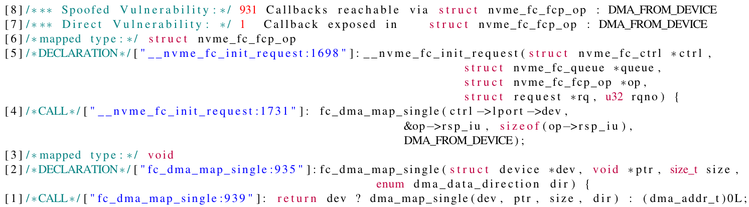


STATIC ANALYSIS TOOL: Output example
structured way of detecting
Notes:
In our work we built a static analysis tool. That searches for Means, an access to a callback pointer. Attempting to exploit type A vulnerability some type B vulnerabilities (these that we know of). This is an example of the tools output. (1)The tool works recursively from a target function. In this case dma_map_single and were looking for the mapped buffer.(+)

Slide 20
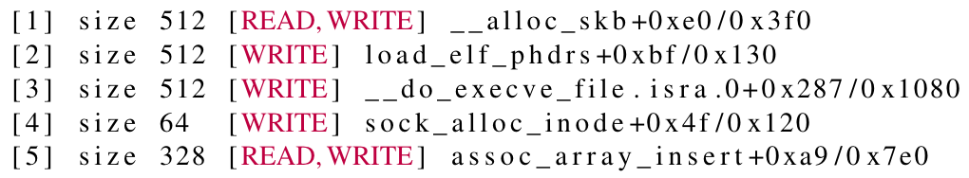
DKASAN
structured way of detecting
Run Time Analysis:
1. alloc-after-map
2. map-after-alloc
3.access-after-map
4.multiple-map

Slide 21
challenges
Cointributions
We present a structured way to reason about DMA vulnerabilities.
Sub-page vulnerability Characterization.
MMO.
Structured way of detecting vulnerabilities.
Static Analysis
Dynamic Analysis
DMA vulnerabilities are not quantified.
DMA attacks are not well understood.

Slide 22
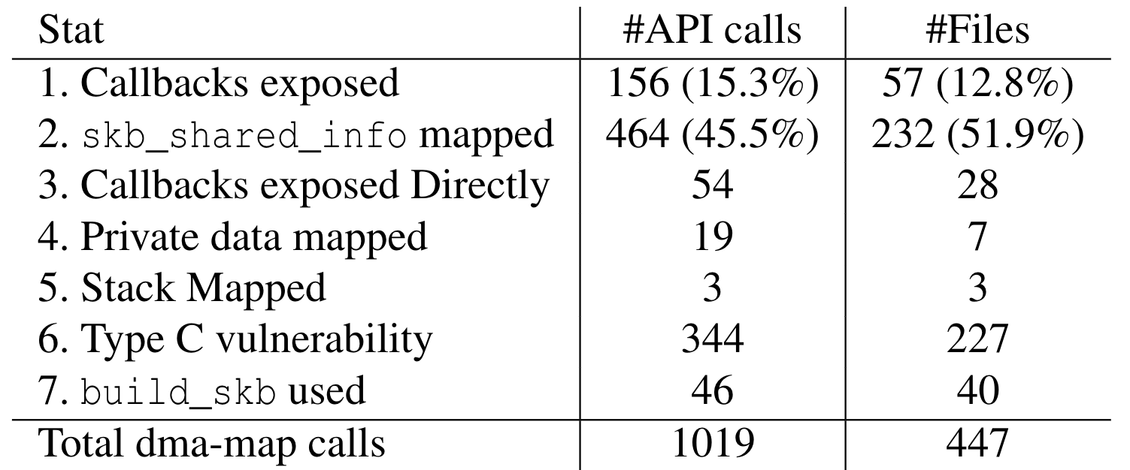
STATIC ANALYSIS TOOL: FINDINGS
vulnerabilities are quantified.
(a)
(b)
(b)
(a)
(c)
(b)
~76% of drivers exposed
~62% of drivers exposed due to OS design choices

Slide 23
challenges
Cointributions
We present a structured way to reason about DMA vulnerabilities.
Sub-page vulnerability Characterization.
MMO.
Structured way of detecting vulnerabilities.
Static Analysis
Dynamic Analysis
DMA Vulnerabilities are quantified.
Linux Kernel 5.0 DMA vulnerability analysis
DMA attacks are not well understood.

Slide 24
Compound attack
DMA attacks are quantified.
No Opportunity
No CPU Address
struct sk_buff {
…
void *data;
…
}
I/O buffer
struct skb_shared_info { skb_frags_t frags[17];
}
Callback
void * destructor_arg;

Slide 25



Compound attack: opportunity
Device Driver
Compound attack
create; unmap
unmap; create
deferred mode
strict mode
Driver Bug
OS design
Type (c) sub page
vulnerability
Opportunity
OS design

Slide 26
challenges
Cointributions
We present a structured way to reason about DMA vulnerabilities.
Sub-page vulnerability Characterization.
MMO.
Structured way of detecting vulnerabilities.
Static Analysis
Dynamic Analysis
DMA Vulnerabilities are quantified.
Linux Kernel 5.0 DMA vulnerability analysis.
DMA attacks characterized.
Compound DMA-Attacks.

Slide 27
QUESTIONS?
CONCLUSION

Slide 28

Compound attack: MOtIVe
Compound attack
POISONED TX

Slide 29
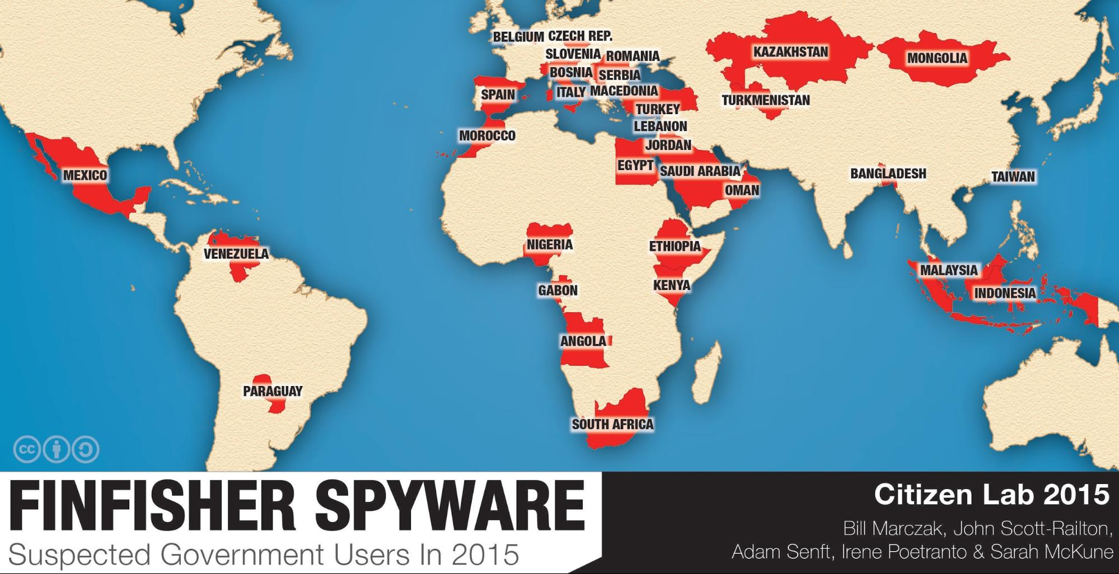
FinFisher Clients
BACKGROUND
Notes:
This was reported by Wikileaks several years ago, and reportedly was used by these state actors. And, Im confident that the US government, China and Russia have their own versions.

Slide 30
DAMN: Overhead-Free IOMMU Protection for Networking
Alex Markuze Igor Smolyar Adam Morrison Dan Tsafrir
Notes:
Hello, my name is Alex and I would like to present today our work “Overhead-Free IOMMU Protection for Networking”.
This work was done by me , Igor Smolyar, Adam Morrison and Dan Tsafrir.
It is part of my Ph.d thesis at the Technion. (0:15)

Slide 31
overview
Background
Characterizing, Exploiting and Detecting
Prevention

Slide 32
Defending
Text
Shadow buffers [ASPLOS 16]
DAMN: DMA aware malloc for networking [ASPLOS 18]
Performance Evaluation
Notes:
We will start with the background. (0:15)

Slide 33
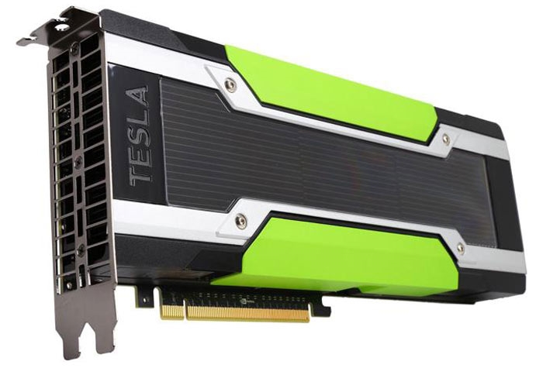
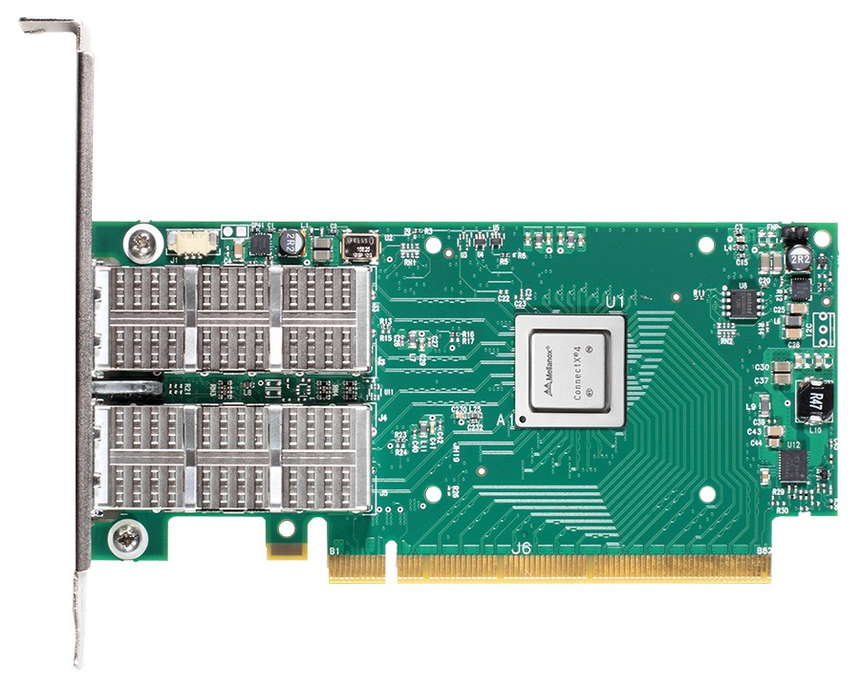

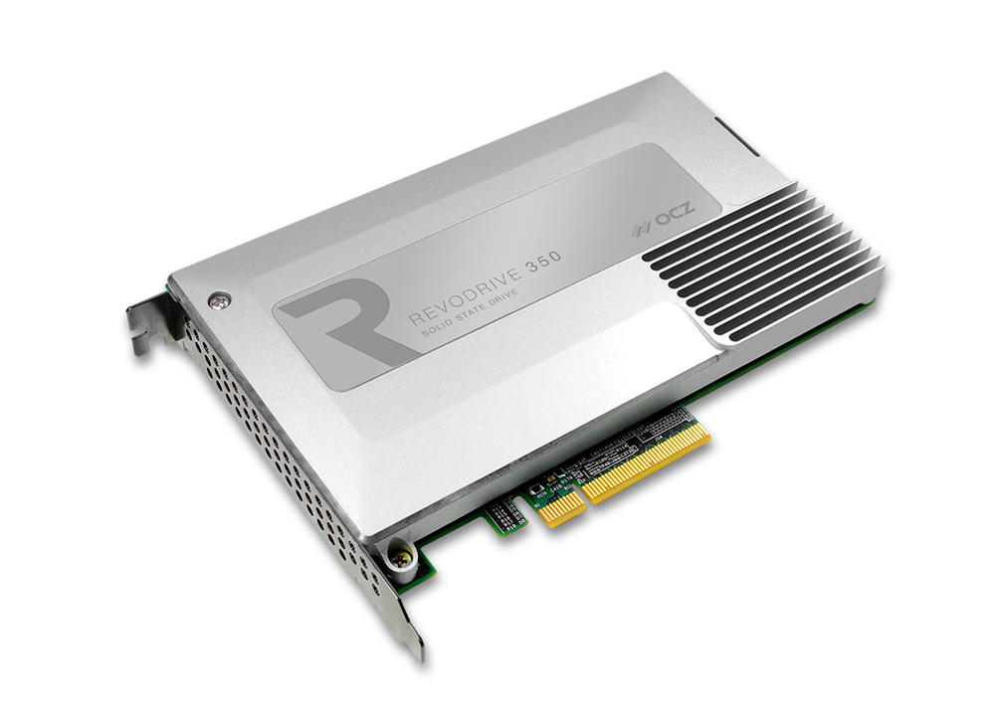
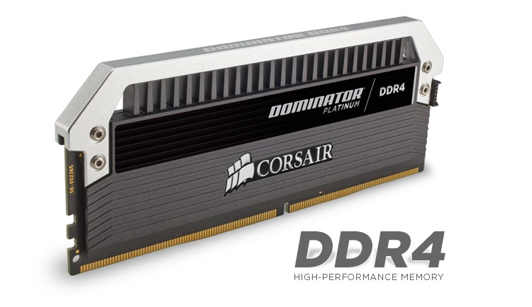
DMA
Direct Memory Access
CPU
Main memory
Notes:
DMA, or direct memory access. Its when, an attached device can access the main memory without involving the cpu.
Thats Devices like GPUs, SSDs and Network Cards . These devices have their own memory and cpus(1) and can obviously run their own code.(0:35)

Slide 34
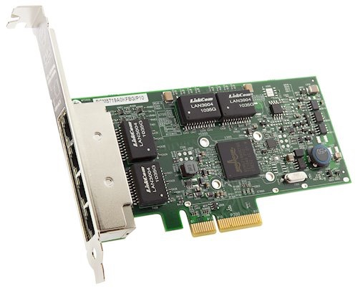


Problem — DMA attacks
Example #1 (out of many)
“How to develop a rootkit for Broadcom NetExtreme network cards” RECON 2011
“What if you can’t trust your network card?” International Workshop on Recent Advances in Intrusion Detection 2011
CPU
Notes:
DMA, also allows a malicious device to read or modify sensitive data. This is called a DMA attack. Just an example; these(1) works describe in detail how to get a malicious code running on this (2) popular NIC, even from remote.(1:00)

Slide 35
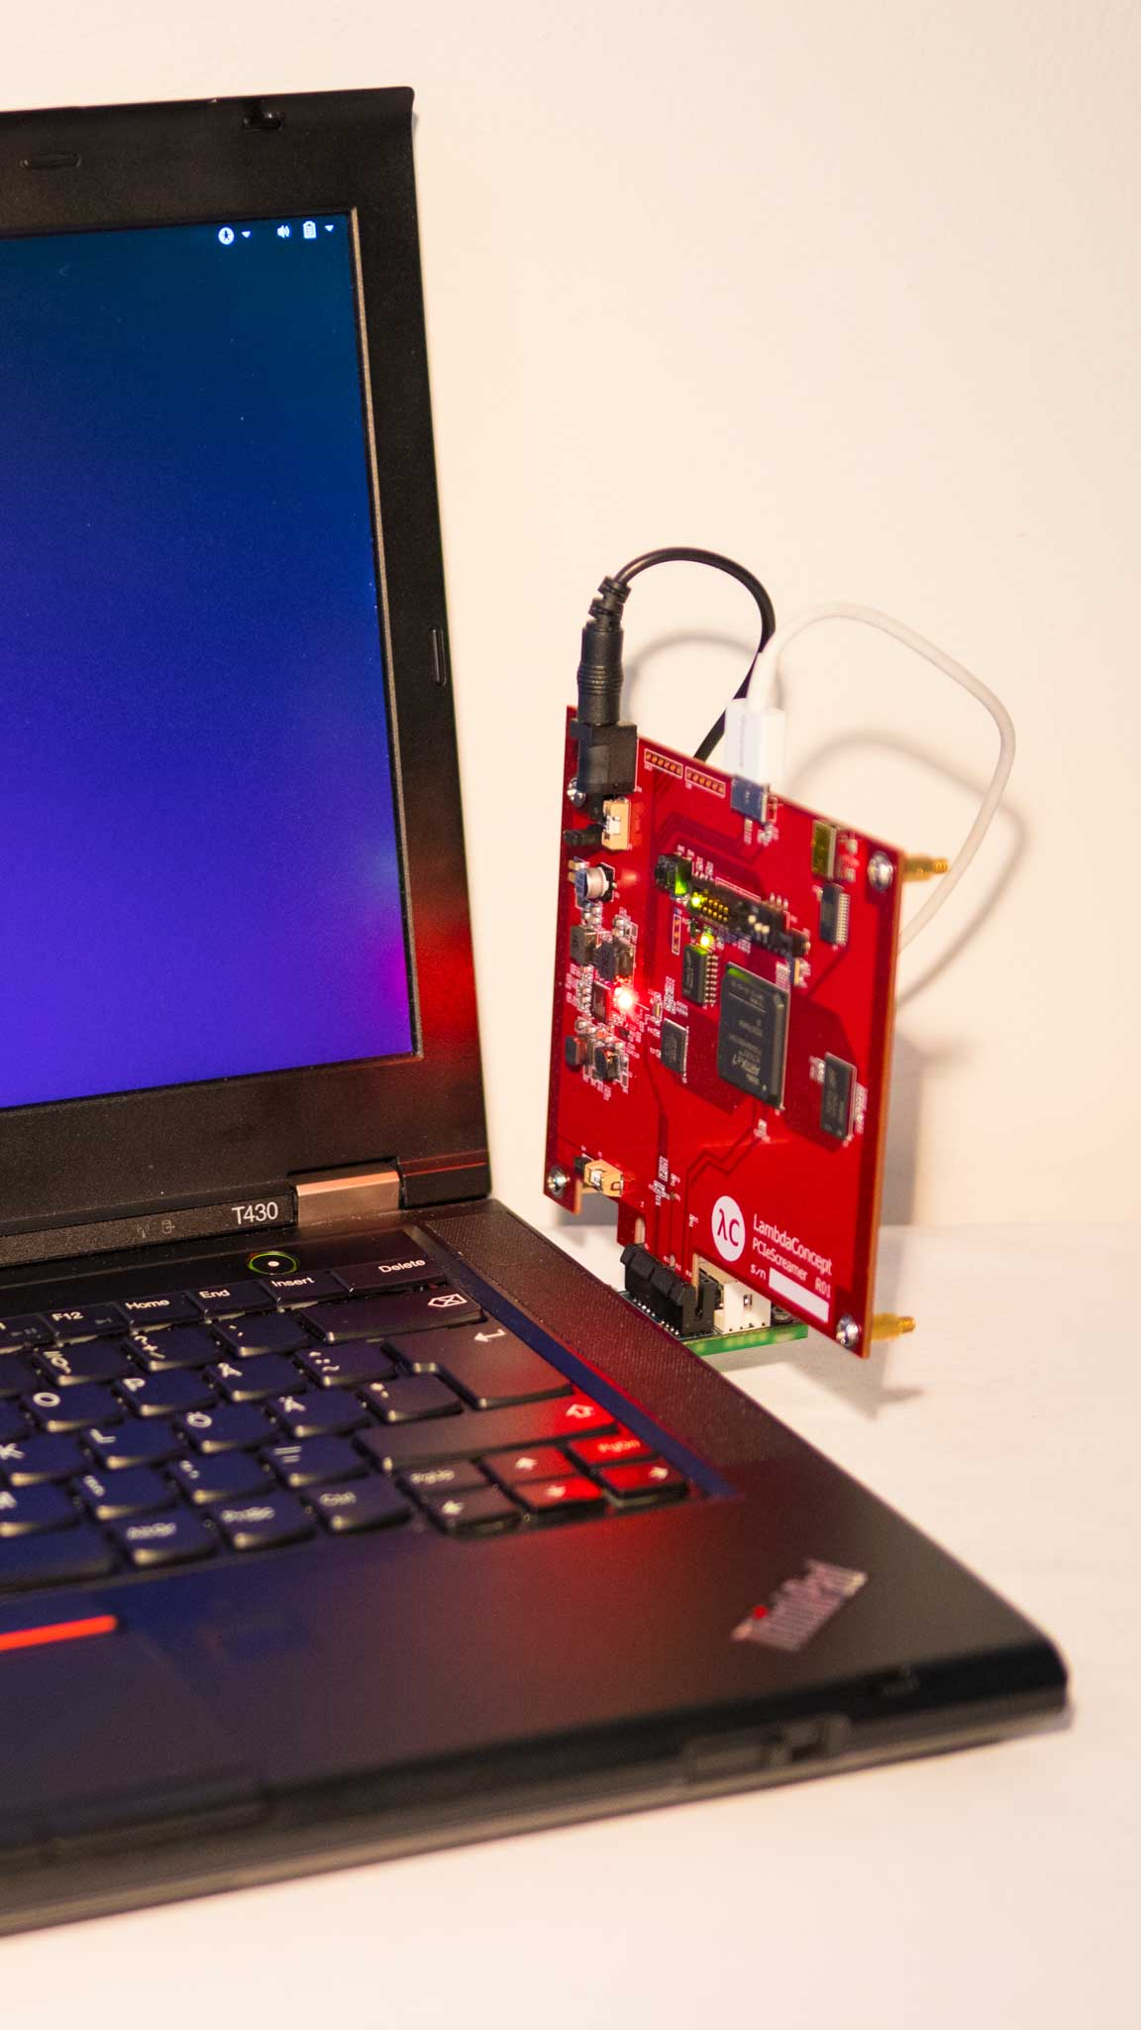
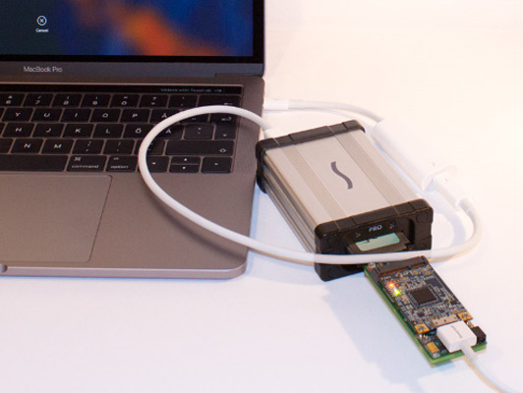
Problem — DMA attacks
Example #2 PCILeech https://github.com/ufrisk/pcileech An active open source project [2018]
Notes:
That was 2011, Today, we have open source projects in GitHub. With detailed examples and tutorials that teach how to conduct a DMA attack via the PCIe Bus. (1:20)

Slide 36
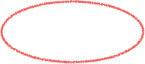

Solution — IOMMU
IO-Virtual Address
Notes:
To prevent arbitrarily access to the memory, modern systems have IOMMU hardware. The IOMMU works for devices just like the MMU works for processes. It provides virtual memory support for the attached device. Meaning, that the device can access only those pages that are listed in the dedicated I/O page table. This page table is controlled by the OS. So, With an IOMMU, the device (1) can access the main memory only via IO virtual addresses, IOVAs.(01:50)

Slide 37
Talk outline
Background
State of the practice
State of the art: shadow buffers [ASPLOS 16]
DAMN: DMA aware malloc for networking
Performance Evaluation
Notes:
Now we cover how iommu is used today (2:00)

Slide 38
IOMMU usage
Made part of DMA API
Drivers remain unaware
Backward compatible
Notes:
When IOMMU was introduced its was integrated into the existing DMA-API, it was the easiest and most natural place to deploy IOMMU protection. Because the code of the driver does not change.
And everything remains fully backward compatible.

Slide 39
Talk outline
Background
State of the practice
State of the art: shadow buffers [ASPLOS 16]
DAMN: DMA aware malloc for networking
Performance Evaluation
Notes:
The latest attempt to solve this issue was presented, by us actually in asplos 16.
Lets go over that solution briefly.

Slide 40
Introducing shadow-buffs
Transmit
dma_map:
Copy to mapped buffer
dma_unmap:
NOP
Receive
dma_map:
NOP
dma_unmap:
Copy to mapped buffer
"True IOMMU protection from DMA attacks: When copy is faster than zero copy."
Markuze, Morrison and Tsafrir. [ASPLOS ’16]
Notes:
shadow-buffers. The basic idea is simple: since the IOTLB invalidations are expensive, avoid them, just don’t Invalidate! Instead, a set of pre allocated and pre-mapped buffers are used. The device can not access anything else. On DMA, the data is copied to these mapped buffers. The overhead of copying has proven to be lower and more scalable than that of updating IOMMU.(5:00)

Slide 41
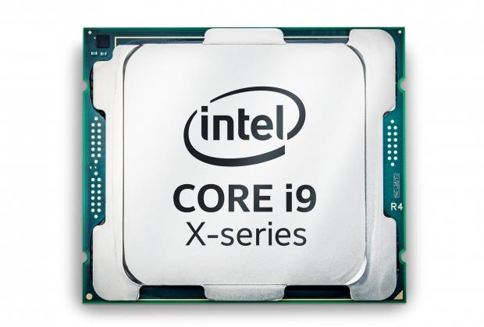
Shadow buffers
Shadow Buffers
user packet
DMA prohibited
network
device
shadow buff
DMA allowed
CPU
packet
packet
Xmit
copy
DMA
Sensitive
data
Notes:
This is the flow. A new buffer which is already mapped is allocated (1). And on dma-map - The data is copied to the already mapped buffer (2). There is no Sub-page problem, because we only copy what’s need and the page with secrets is never mapped. Also There is no bottleneck on the iommu HW. (5:30)

Slide 42
Shadow-buff performance 40Gb/s
Shadow Buffers
Single Core RX flow
16 Core
Notes:
This is the performance with 40GbE, we have seen this graph before. But now we have added the yellow bar which represents shadow-buff performance.
(1)Which are much better for multicore as well.
(5:45)

Slide 43
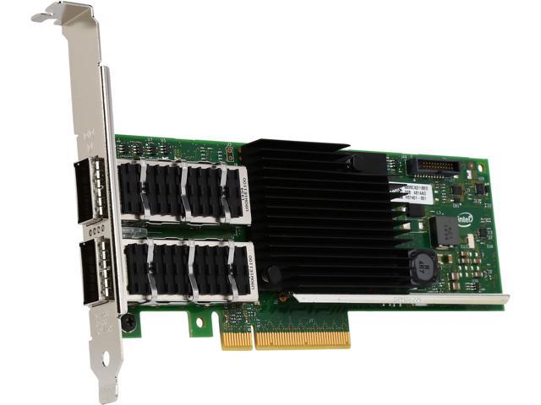
Moving from 40Gb/s to100Gb/s
Mellanox ConnectX-4
100 GbE
Intel XL710 40GbE
Notes:
With this Intel 40GbE Nic shadow-buffers looks great, but (1)
we got our hands on a new (2) 100GbE nic, lets see what happens (6:00).

Slide 44
Shadow-buffs breaks with >=100Gb/s
38%
Notes:
With 100Gb/s copying becomes an issue. What we see here is a single core performance for the Connectx-4 NIC with more HW offloads and 9K jumbo frames, the performance numbers are higher even for a single core. And shadow-buffs underperforms significantly(1).
And this is not even the biggest issue. (6:30)

Slide 45



Concurrently with Graph 500
51%
Notes:
The real problem is how copying effects running processes. In this example we ran a cpu only; Graph500 benchmark. The benchmark attempts to measure Giga-traversed edges per second, its a memory bound benchmark. We ran Graph500 concurrently with a network load on separate cores. 24 cores for the benchmark and 4 cores for the network. The faster the computation ends the better. The application running (1) alone, takes 45 seconds (2). With I/O (3) but without protection the time goes up to 47 seconds (4). But when shadow buffers (5) are used run time is increased(6) by 51%(7), as compared to the time it takes for the application alone.
This is due to the load on the memory controllers. (7:20)

Slide 46
Talk outline
Text
Shadow buffers
DAMN: DMA aware malloc for networking
Performance Evaluation
Notes:
Now lets talk about our current solution. (7:30)

Slide 47
Problem: protection @ DMA API level
• Allows device to access buffer only between map/unmap
• Which inherently imposes per-DMA overhead
◦ If zero-copy with IOMMU map+unmap (state-of-the practice = Linux “strict” IOMMU protection)
1. unmap hampers performance 2. Insecure (no sub-page protection)
◦ If copy (state-of-the-art = shadow buffers [ASPLOS’16])
▪ Then copy hampers performance
New approach, change the API semantics!
Notes:
We finally realized that the root cause of all these problems, IS the DMA API, (1) it allows a device to access a memory buffer only during the time interval at which the buffer is mapped. (2) This inherently means that we must do *some* work on map/unmap: be it the zero-copy (3) with IOMMU(4) update per packet, or (5); copy, with shadow buffers, which gets rid of the IOMMU overhead but replaces it with copying overhead(6). No matter what you do, providing protection at the DMA API level will always come at a price(7). So we thought (8): maybe we can we relax this API constraint? (8:15)

Slide 48
Solution: decouple protection from DMA API
NIC
can modify
• Key idea
◦ Data remains mutable beyond DMA unmap
• Everything device writes after unmap
◦ Was also able to write before
• To be safe, ensure that
◦ Data remains unchanged after CPU reads it
DMA unmap
CPU read
NIC
Can’t
modify
Time
• Which standard network stacks do in any case!
◦ When copying data to user
Memory
Notes:
Our idea in this work is to keep the data mutable by the device even after a DMA unmap. (1+2) This is OK, because anything the device writes after the unmap, it could have just as well written before. The real security guarantee we need is that once the CPU reads a byte(3), the device (4)must no longer be able to change it. Fortunately, for most bytes, this is actually *already* taken care of, because the network stack will copy the data when send or receive system calls are called. (9:00)

Slide 49
Challenge: preventing “TOCTTOU” attacks
• TOCTTOU
◦ Time of check to time of use
• Happens when kernel reads+uses data
◦ Before copy to user
• Kernel assumes data remains unchanged
◦ Device might violate this assumption
• Examples:
◦ packet headers: Used to identify socket, for example
◦ firewall / iptables : Typically relies on packet headers
DMA unmap
NIC
can modify
CPU read
NIC
Can’t
modify
Time
Memory
Notes:
The only problem is with those bytes that are read and used by the kernel before returning to the user, like the packet headers. The existence of such read operations creates the possibility of TOCTTOU (1)— or time of check to time of use -- attacks. A TOCTOU attack (2) happens when the data is modified between two CPU reads(3) and thus subverting the kernel(4). Which assumes that the data has not changed between the two reads(5).
For example (6) packet headers(7+8) can be manipulated to bypass a firewall rule.
We have to protect such reads. And I’ll describe how we do this shortly. (09:45)

Slide 50
Implementation
• Revise network stack to use a new allocator, called “DAMN”
◦ DMA-aware malloc for networking
• Each allocated page permanently mapped to IOVA
• (De)allocation
◦ Alloc: via functions analogous to standard Linux’s alloc_page / kmalloc
◦ Free: via Linux’s standard free_page / kfree
◦ Released upon memory pressure via standard Linux interface (“shrinker”)
• IOVA encoding
◦ Optimized to allow speedy identification of buffer’s properties
• Preventing TOCTTOU
◦ Accesses to packet bytes done via accessor functions (e.g., skb_seq_read), as packet data is often not contiguous -- we create a copy then.
Notes:
We have implemented our solution in kernel 4.7 and recently ported to the newer kernel 4.14.
We have added a new memory allocator (1). DAMN - dma aware malloc for networking (2)
We have modified the Linux network stack, specifically TCP and UDP to use our dedicated memory allocator.
(3) Each page given by damn is already dam -mapped. (4)Damn allocation API (5)is analogous to that of the linux kernel. (6)The pages can be freed with standard kfree/free_page. We had to update the kernel memory management code to support this . We also support (7)the shrinker mechanism that may reclaim pages in the case of memory pressure.
(8) We encode the IOVA, the I/O virtual address with additional (9)information to improve performance. More details in the paper (10+11).
(12) And finally in order to prevent TOCTOU, we modify accessor functions that touch the packet payload. (13) The packet in linux is represented by an sk_buff struct or skb. This skb is accessed via special accessors because it is often discontiguous and built with scatter gather vectors. (11:00)

Slide 51
Gains
• Send always benefits
◦ Copies data to DAMN buffers when entering kernel
◦ This is the only copy, and no map+unmap
• Receive usually benefits (= always, except special cases)
◦ Header -- typically copied in any case upon receive
◦ Payload -- copied as late as possible, typically when leaving kernel
▪ Otherwise, another copy of accessed bytes is required
Notes:
What do we gain by relaxing the constraint of dam-api?
Now Send is always penalty free - the data is copied to the kernel and immediately can be read by the device. Security is not compromised by the fact that the NIC can read the headers/payload as they are being built. Because it will read them anyway eventually. DAMN also guarantees sub-page protection, because there's no co-location of network buffers with other data. The NIC can only access pages managed by DAMN, which by definition only contain data it's allowed to access.
(2) Receive is more delicate, the headers are always read by the cpu so we always copy them. But they are already often copied anyway in the drivers we have seen. The payload is intended for user space so it wouldn’t be touched in the common case. The data becomes immutable when it is copied from the kernel to user space by the receive system call.
In the rare case, the payload is accessed in the kernel, we copy the accessed bytes. (11:45)

Slide 52
Talk outline
Text
Copy protection
DAMN: DMA aware malloc for networking
Performance Evaluation
Notes:
So how does the performance look now?
11:50

Slide 53
Single core performance
59%
38%
Notes:
On single core both Send(1) and receive(2) are on par with no-iommu. While shadow-buffers struggle(3).
(12:10)

Slide 54
multicore performance (transmit)
+2.5 cores
80%
Notes:
Now we look at multicore performance, the left graph(1) shows all solutions reaching 100Gb/s.
While the right(2) graph is showing the correlating cpu utilization.
shadow-buffs need (1) 80 percent more cpu. (2) Or 2.5 full cores. While damn is the same as no-iommu. (12:40)

Slide 55
Concurrently with Graph 500
151%
Notes:
This is the graph we saw earlier. We measure the impact of copy on a running application. damn (1) has no additional over head over no iommu. (13:00)

Slide 56
Limitations
Zero copy
NVMe
Tunneling & packet forwarding — requires additional development
Multiple device support — requires additional development
Notes:
There are obviously some limitations to our approach.
Zero copy is not supported, atleast one copy is needed to make the data immutable.
The approach is not applicable to NVME/HDD devices. Disk I/O is buffered with page-cache.
Exposing the page-cache to the device will compromise security.
Tunneling and Packet forwarding - require additional development.
So does the support for multiple I/O devices.
(14:30)

Slide 57
Summary
Currently
Fine grained control over NIC access doesn’t really exist
Trying to do so; hurts performance
Instead
Allow the NIC to read/write any time
But, Control what it can touch
Notes:
Currently
Fine grained control over NIC access doesn’t really exist
As we have seen with sub page protection
An we also know that attempts to do so don’t scale.
Instead
Allow the NIC to read/write any time but do have control over where it can do so.

Slide 58
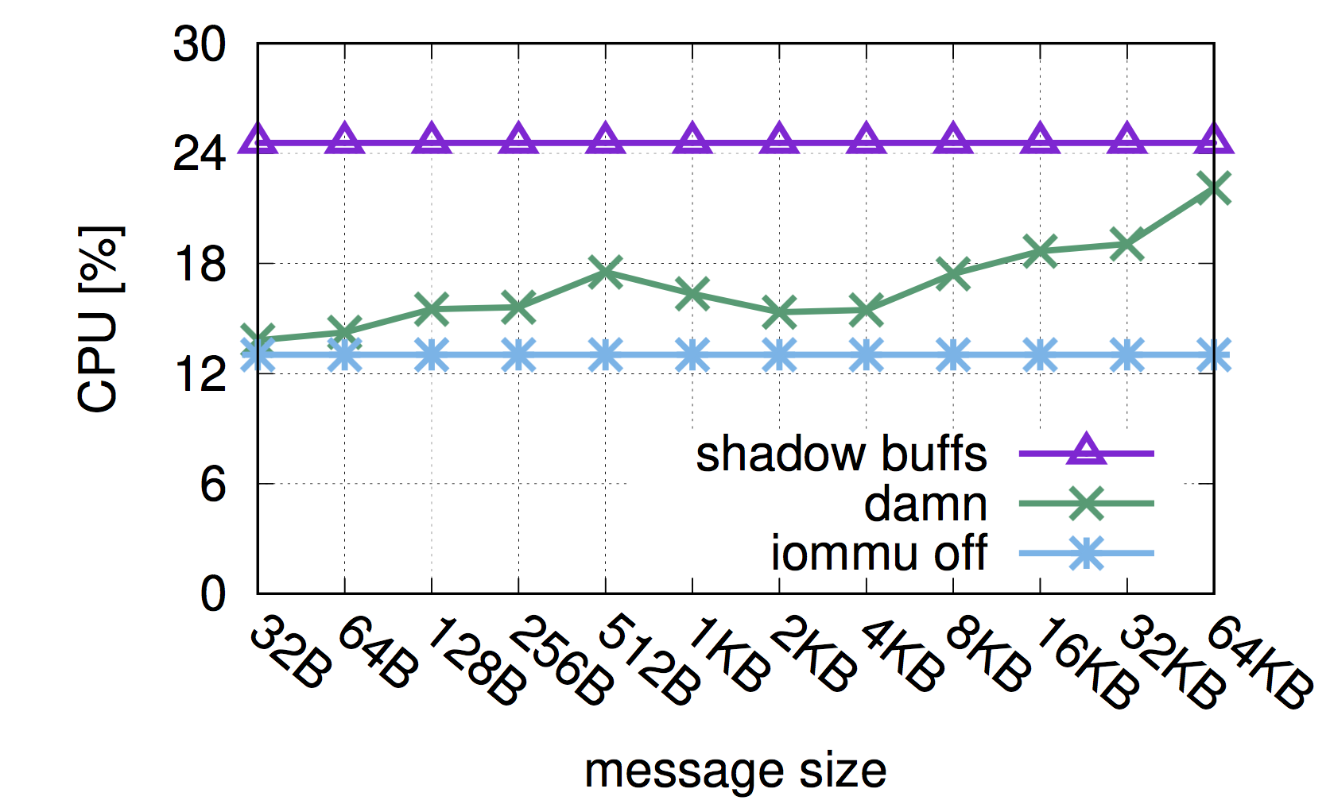
TOCTOU protection
Notes:
We evaluate the cost of copying the data on the fly depending on the portion of the packet that is accessed.
The packet is 64KB. When only the headers are touched DAMN is on par with no iommu.
When the whole packet is read, DAMN performance drops close to that of shadow-buffers.
(13:30)

Slide 59
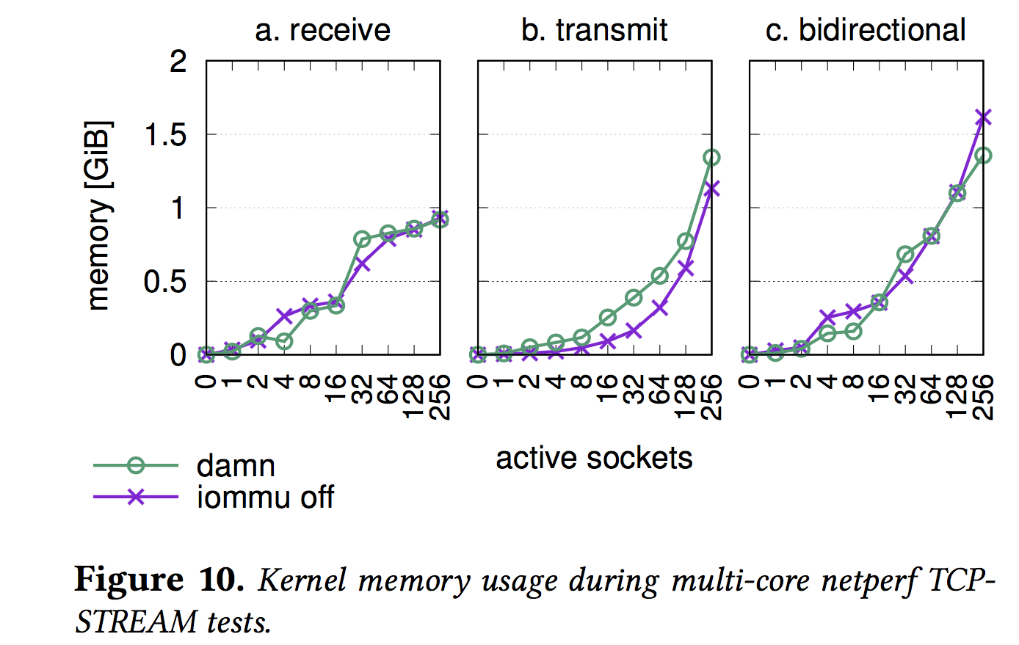
Memory Usage - is similar
Notes:
The memory consumption depends mostly on the number of active sockets. Here we compare the size of the DAMN memory consumption vs the memory used by the original network stack during I/O. Y axis is the memory used in GB and X axis is the number of used sockets. As we can see memory consumption is similar. The main difference is that DAMN will return the pages on memory pressure - on demand. And vanilla will return back close to its initial size.
(14:00)

